Slide 1
IS4432 Systems Design
Week 8 – Input Design
Adapted by Janet Yu
Week 7 – User Interface Design
Adapted by Janet Yu
115/11/07

Slide 2
Agenda
Principles for User Interface Design
User Interface Design Process
Interface Standards Design
Interface Design Prototyping
Interface Evaluation
Navigation Design
115/11/07

Slide 3
User Interface Design
What is user interface?
  The part of the system with which the users interact.
Three parts of user interface design:
  Navigation mechanism – the way in which the user gives instruction to the system
  Input mechanism – the way in which the system captures information
  Output mechanism – the way in which the system provides information to the user
115/11/07

Slide 4

User Interface Design
Simplicity and pleasant appearance
Presenting information across multiple screens
115/11/07

Slide 5
Principles for User Interface Design
115/11/07

Slide 6
Principles for User Interface Design
Layout - Consistent use of screen area
Content awareness - Users know where they are
Aesthetics - White space vs. functionality
User experience - Ease of use vs. learning curve
Consistency - User can predict what will happen for each action
Minimal user effort - Simple to use, three click rule
115/11/07

Slide 7
1. Layout
Screens are generally divided into 3 areas:
  Navigation area
  Work area
  Status area (usually at the bottom)
115/11/07

Slide 8

115/11/07

Slide 9
Layout
Areas can be subdivided into sub-areas to hold different information eg customer info section, order general info section, order details section.
Ideally, areas will remain consistent in size and shape
115/11/07

Slide 10
Layout
Areas should have a natural intuitive flow
  Top to bottom
  Left to right
  Chronological order
  General to specific
  Most frequent to least frequent
  Vertical vs Horizontal
115/11/07

Slide 11
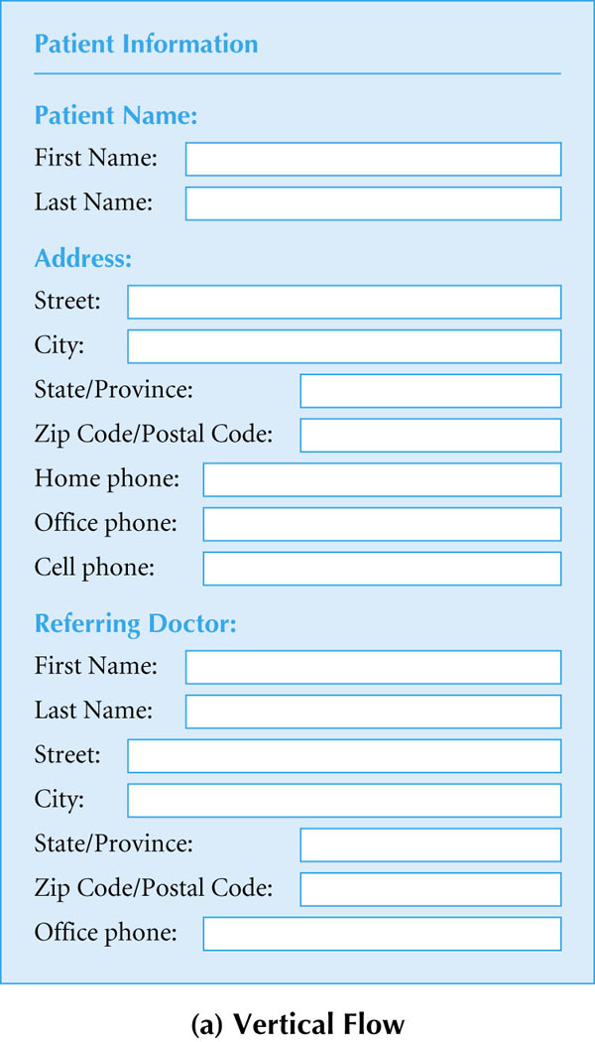
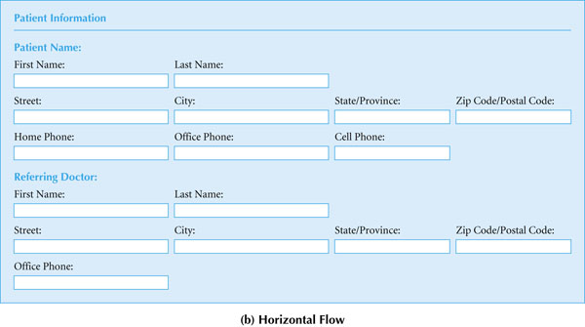
115/11/07

Slide 12
2. Content Awareness
Users should be aware of where they are in the system and what information is being displayed
  All interfaces should have titles
  Menus should show where we are and how to get there
  Fields may need explicit explanation
  Field labels should be short and specific
  Forms or reports should have preparation date (eg date printed)
115/11/07

Slide 13
3. Aesthetics
Need to be functional and inviting to use (pleasing to the eye)
Avoid squeezing in too much information
  Particularly for novice users (prefer low density eg 50%)
  Experienced users can handle more info (prefer high density eg 90% to reduce physical movement thru the interface)
Design text carefully
  Be aware of font and size
  Avoid using all capital letters except possibly for titles
Use colors and patterns with caution
115/11/07

Slide 14
4. User Experience
Novice users or infrequent users prefer ease of learning
  Prefer menus showing all available functions
Frequent users prefer ease of use
  Prefer fewer menus organized around the most commonly used functions
  Consider shortcuts for the expert
In general, put more emphasis on ease of use rather than ease of learning
115/11/07

Slide 15
5. Consistency
Enable users to predict what will happen to reduces learning curve
  Consistency among screens in a system?
  Consistency with other systems in the organization?
  Consistency with commercial software eg Windows?
Use standard interface objects eg list boxes, pull down menus, and radio buttons
Watch out for terminology (eg not customer on one screen and client on another screen)
115/11/07

Slide 16

6. Minimize User Effort
Three-click rule
  Users should be able to go from the main menu to the information they want
    In no more than three clicks or keystrokes
115/11/07

Slide 17
User Interface Design Process
115/11/07

Slide 18
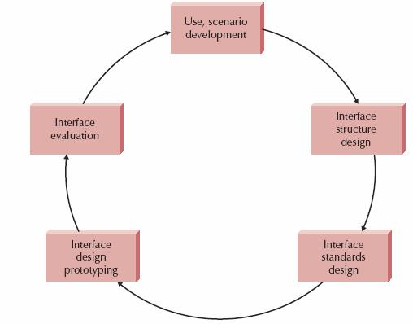
User Interface Design Process
115/11/07

Slide 19
Five-Step Process
Use Scenario Development
    Look at use cases and the descriptions
    Understand the steps users use to perform their work
Interface Structure Design
    Develop Window Navigation Diagram (WND)
    Most systems have several WNDs, one for each major part of the system
    Similar to a behavioral state machine but models the state changes of the user interface
115/11/07

Slide 20
Five-Step Process
3. Interface Standards Design
    Standardize the interface objects, interface actions, icons
    Have an interface template
4. Interface Design Prototyping
    Mock-up of computer screens, forms and reports
    One for each interface in the system
5. Interface Evaluation
    Are the interfaces ok?
115/11/07

Slide 21
Interface Structure Design
115/11/07

Slide 22
Interface Structure Design
Window navigation diagram (WND)
  Shows how all screens, forms, and reports are related
  Shows how user moves from one to another
How to draw
  A box corresponds to a user interface component, such as a window, form, button, or report
  Transitions are modeled as a single-headed (return not required) or double-headed arrow (return required)
  Stereotype modeled as a text item enclosed in guillemets <<>>. It represents the type of user interface component
115/11/07

Slide 23
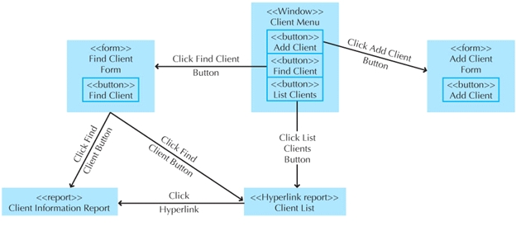
Window Navigation Diagram
115/11/07

Slide 24
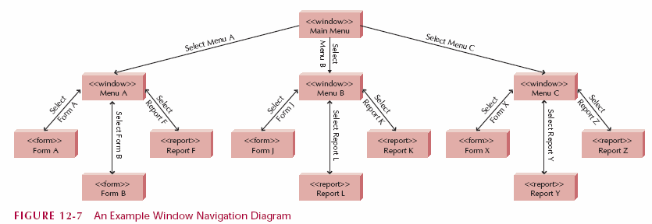
Window Navigation Diagram
115/11/07

Slide 25
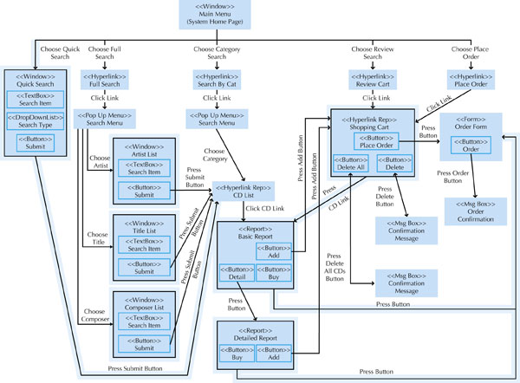
Window Navigation Diagram
Figure 11.20
115/11/07

Slide 26
Interface Evaluation
115/11/07

Slide 27
Interface Evaluation
Understand how to improve the interface design before the system is finished.
Have as many potential users as possible to evaluate the interface – at least ten
Should be performed while the system is being designed, not after
115/11/07

Slide 28
Interface Evaluation Approaches
Heuristic
  Compare the interface to a set of heuristics or principles for interface design – checklist developed by the project team
  At least 3 project team members individually go through the checklist against prototype and then discuss findings together
Walkthrough
  Project team presents and walks through the prototype to a group of representing users
115/11/07

Slide 29
Interface Evaluation Approaches
Interactive
  Users actually work with the prototype in a one-person session with project team members.
Formal Usability Testing
  Users also work with the prototype in a one-person session
  But done in a special lab equipped with video cameras and special software that records each and every keystroke and mouse operation
  The user is given a specific set of tasks
  Very formal, for commercial software products
115/11/07

Slide 30
Navigation Design
115/11/07

Slide 31
Navigation Design
The fundamental goal of navigation design is to make the system as simple to use as possible
115/11/07

Slide 32
Basic Principles
Prevent mistakes
  Limit choices
  Gray out or not display commands that can’t be used
  Confirm actions that are difficult or impossible to undo
Simplify recovery from mistakes
  Consider undo button, transaction rollbacks and automatic backups
Use consistent grammar order
  Most systems use object-action order (ie first choose the object, then the action) (eg first highlight text, then choose ‘copy’)
115/11/07

Slide 33
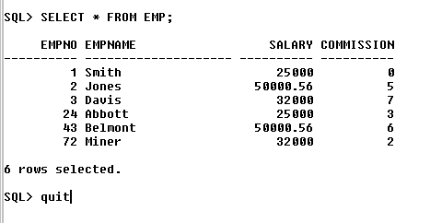
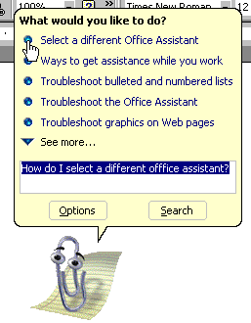
Types of Navigation Controls
Languages
  Command language
    User enters commands
    using special language
    Hard to learn, fast and easy
    to use
  Natural language
    Use a conventional speaking
    language like English
    Easy to learn
    Slow and imprecise
115/11/07

Slide 34
Types of Navigation Controls
Menus
  Present a user with a list of choices
  Are usually preferred to languages
  Easier to learn
  Taking submenu into consideration, it’s better to make menus broad and shallow
  Consider using “hot keys” (eg Ctrl-C for copy)
  Put together like items
  Common types: menu bars, drop-down menus, pop-up menus, tab menus, toolbars & image maps
115/11/07

Slide 35
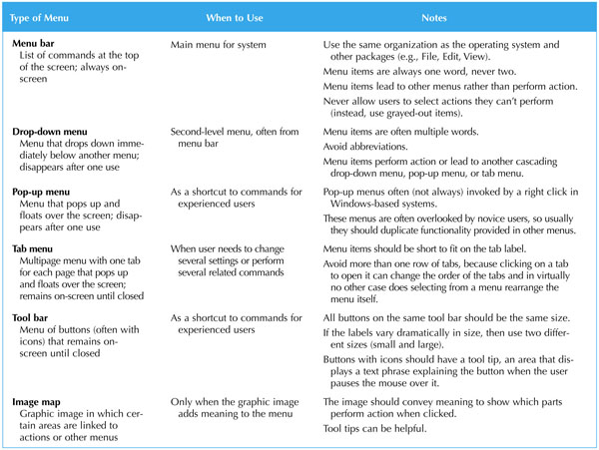
115/11/07

Slide 36
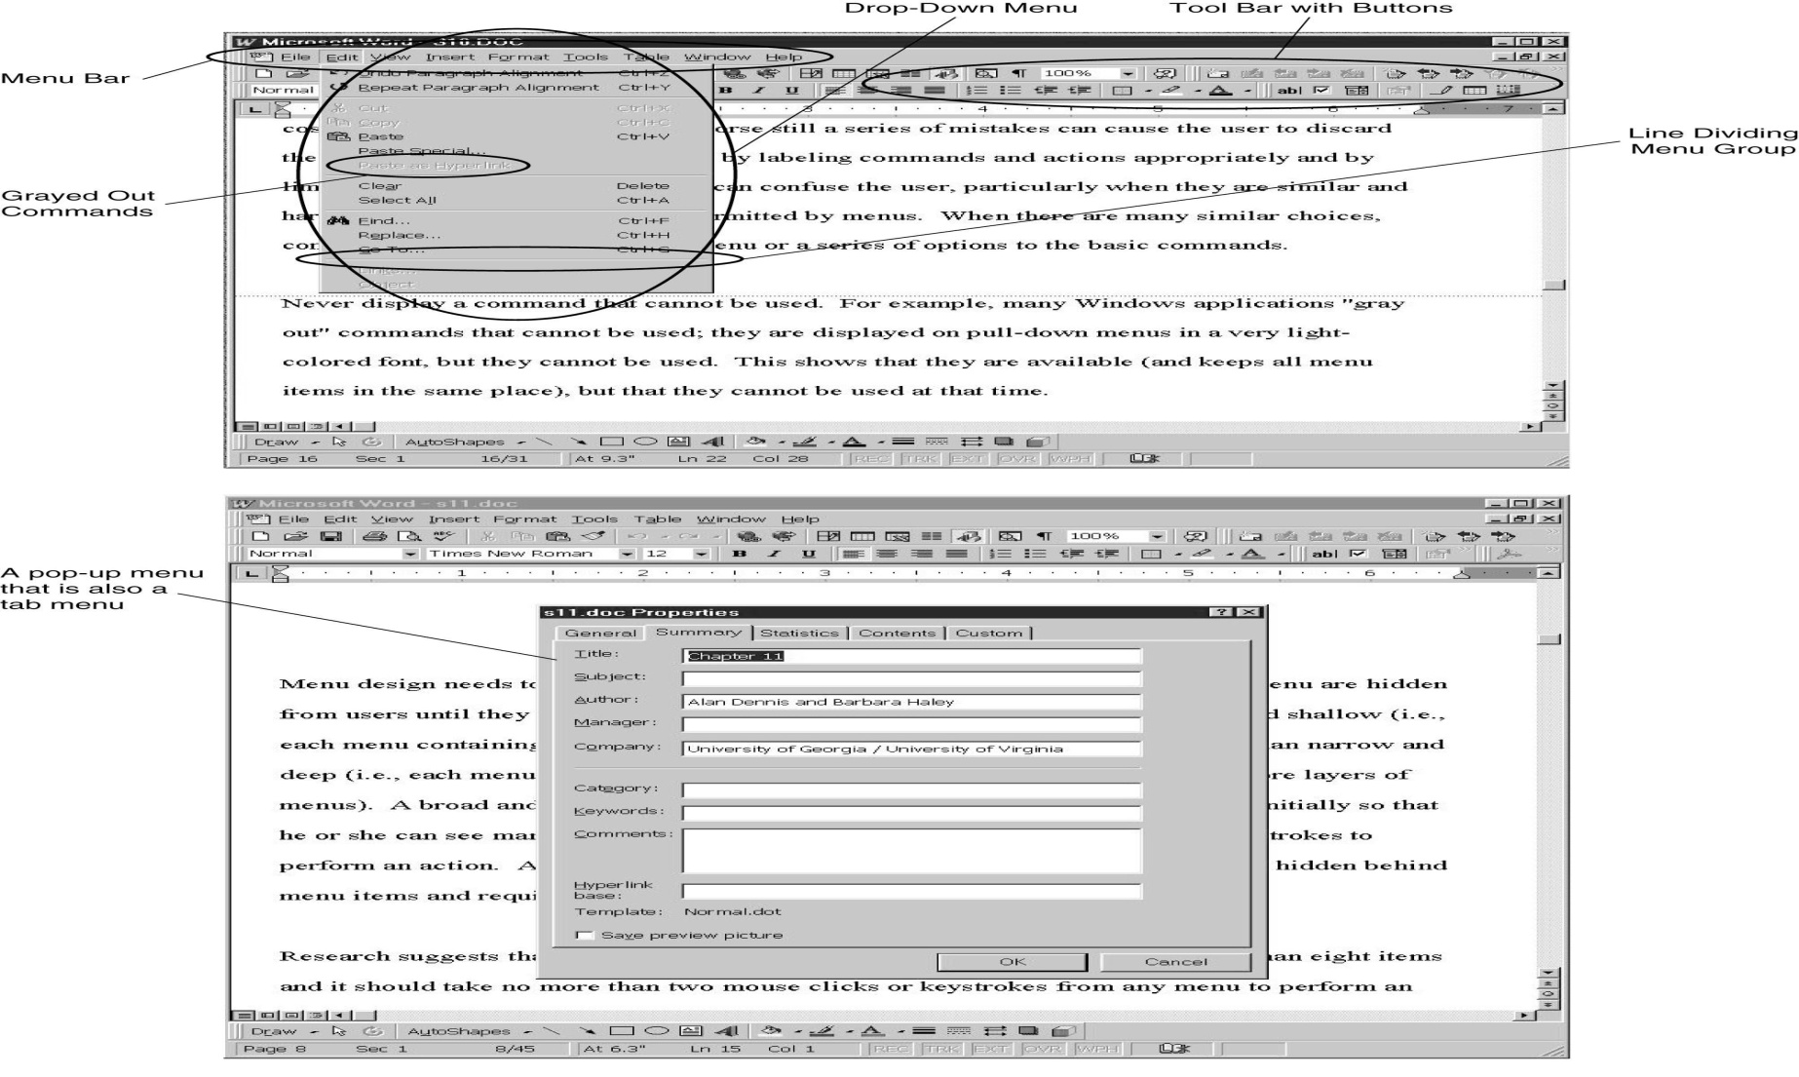
115/11/07

Slide 37
Types of Navigation Controls
Direct Manipulation
  Work directly with objects
  Eg in powerpoint, click an object, move the sides to resize
115/11/07

Slide 38
Messages
Types of messages
  Error messages
  Confirmation messages
  Acknowledgment messages
  Delay messages
  Help messages
Should be clear, concise, and complete
Should be from users’ perspective
Avoid negatives (eg Are you sure you do not want to continue?)
115/11/07

Slide 39
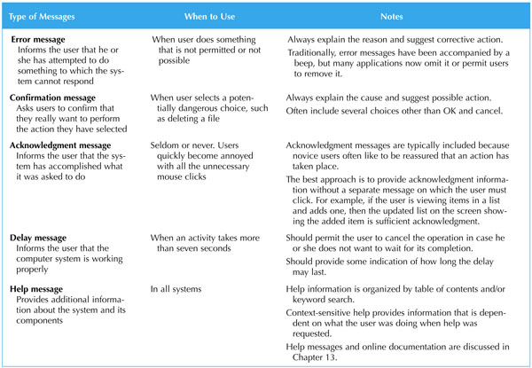
115/11/07

Slide 40
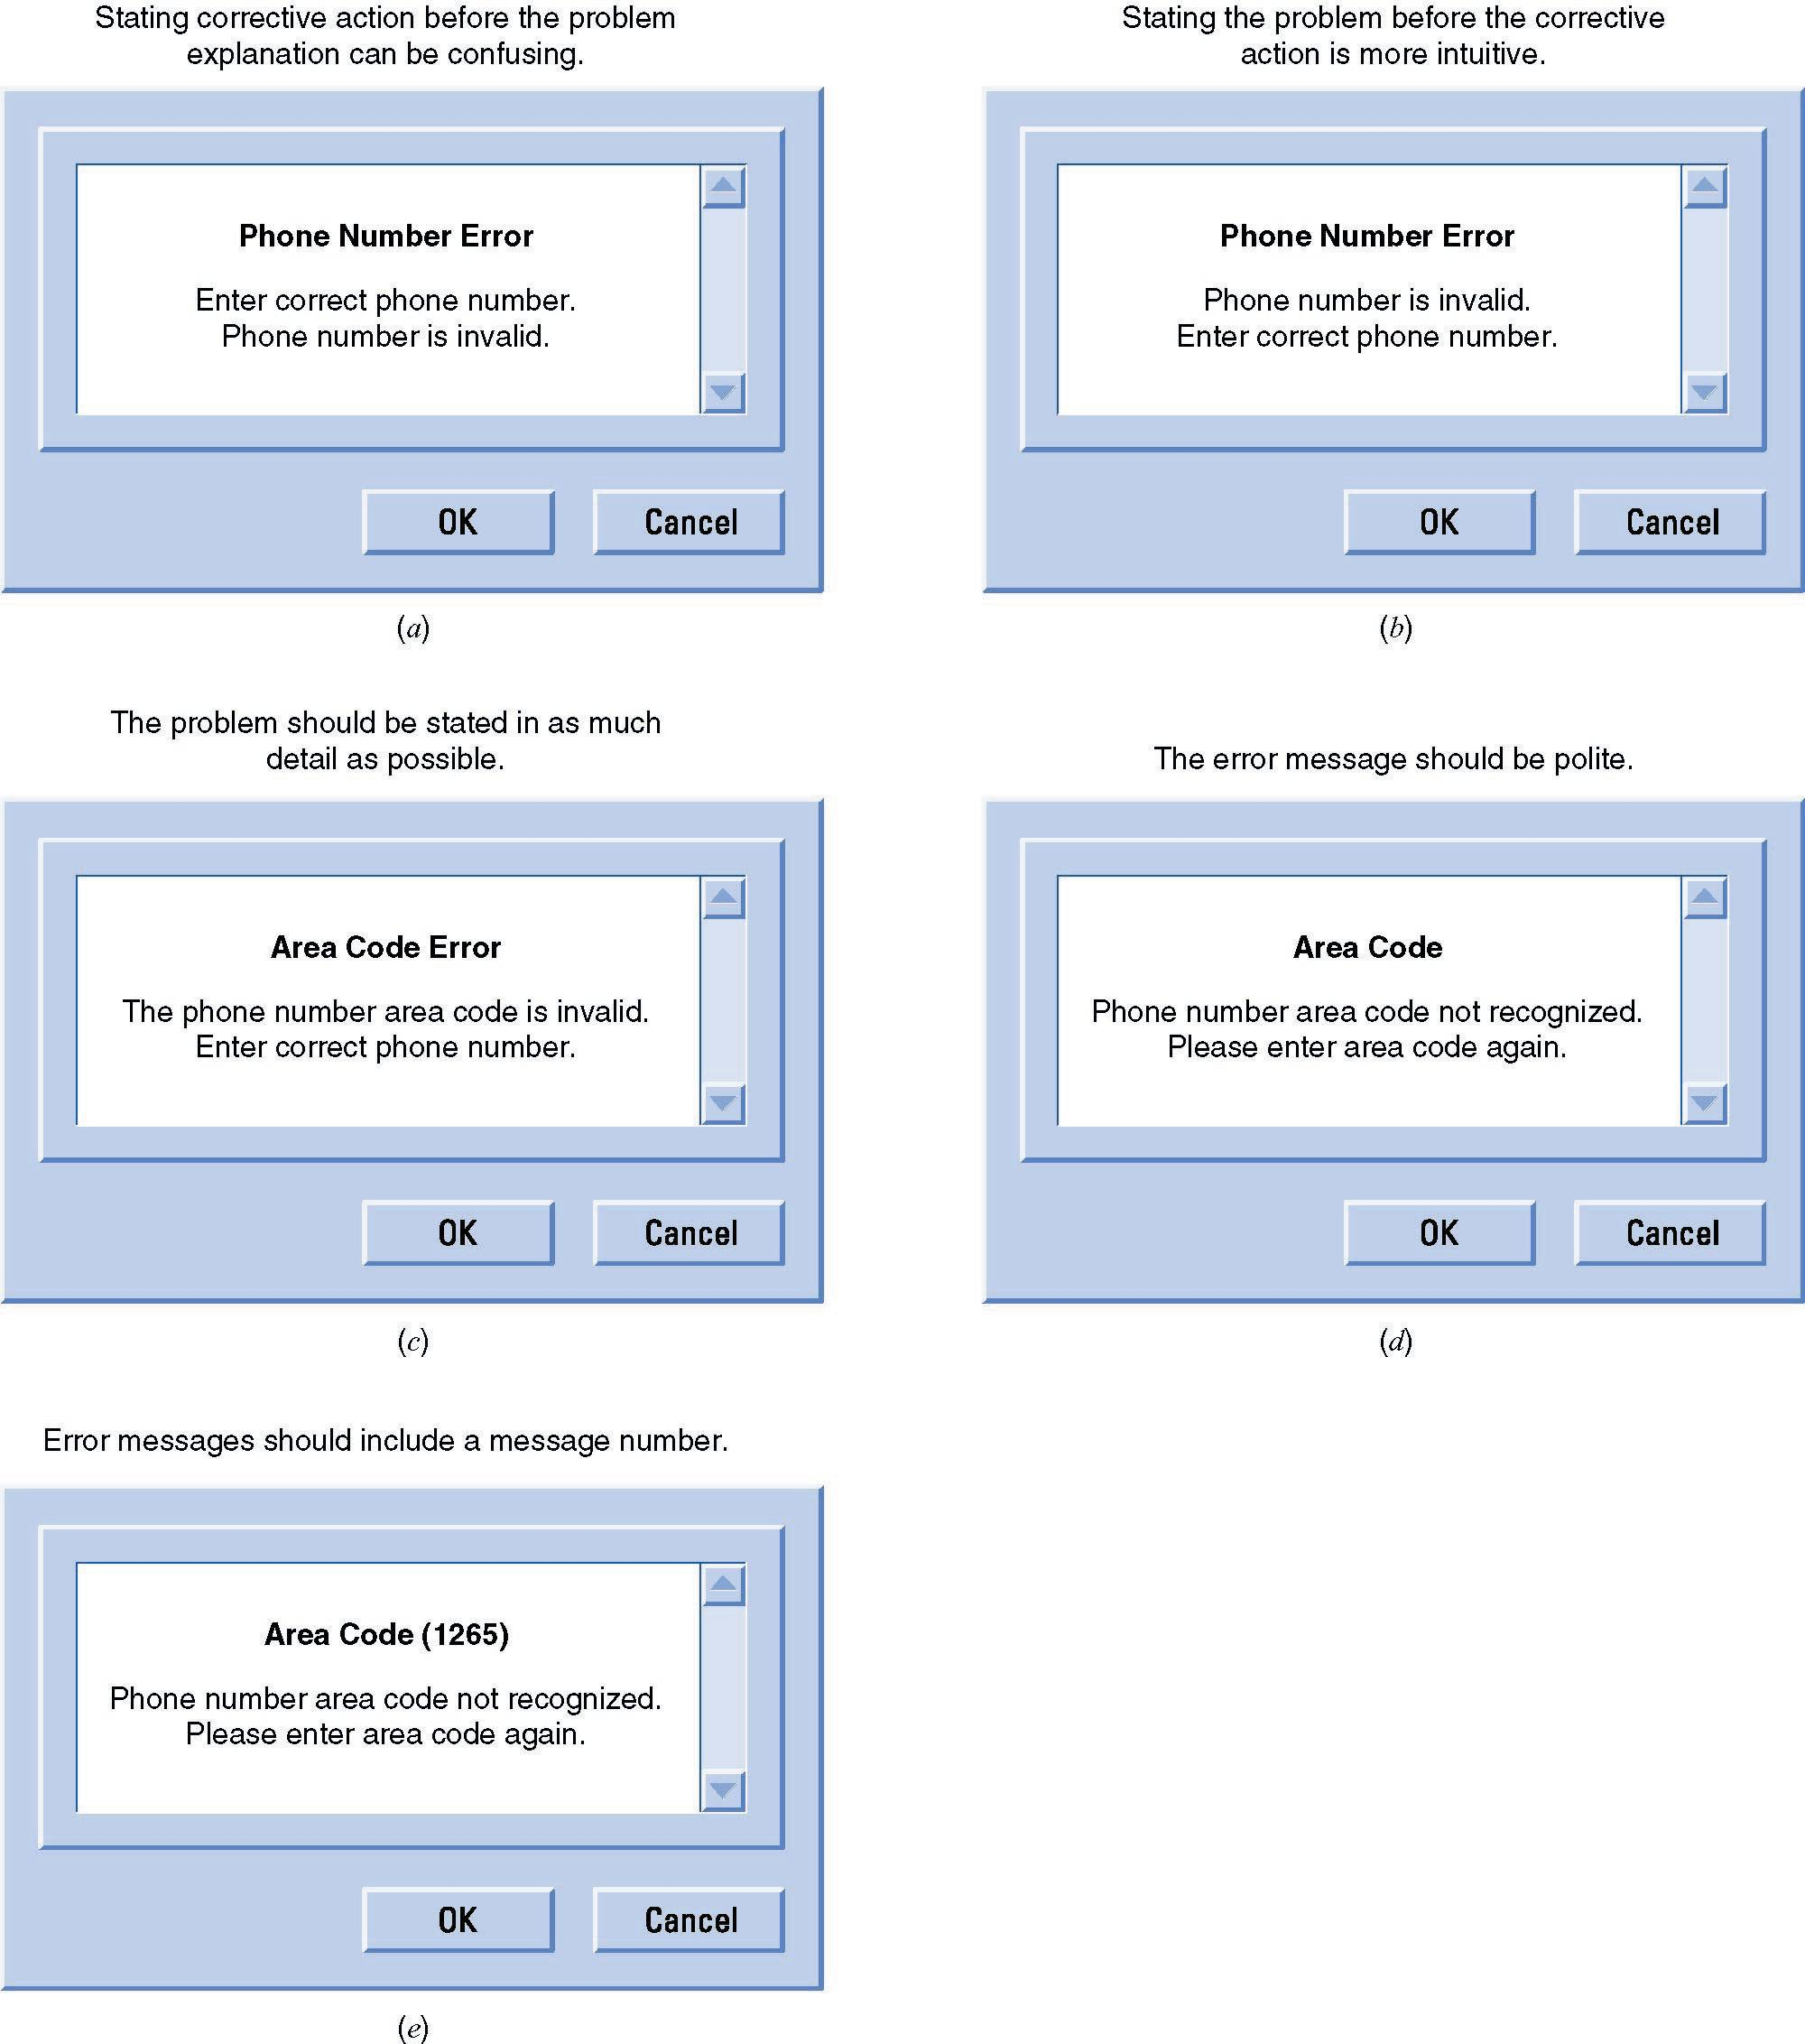
Sample Messages
115/11/07

Slide 41
Considerations for Mobile Devices
Mobile devices vs. Desktop PCs
Much smaller viewable area
Limited number of colors
Limited graphics supports
Hard-to-use Input devices
But differences are blurring …
115/11/07

Slide 42
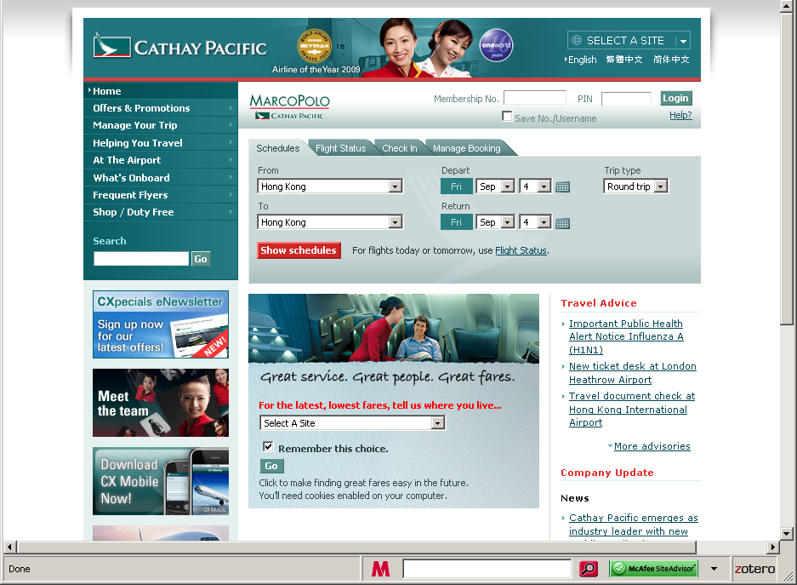
115/11/07

Slide 43
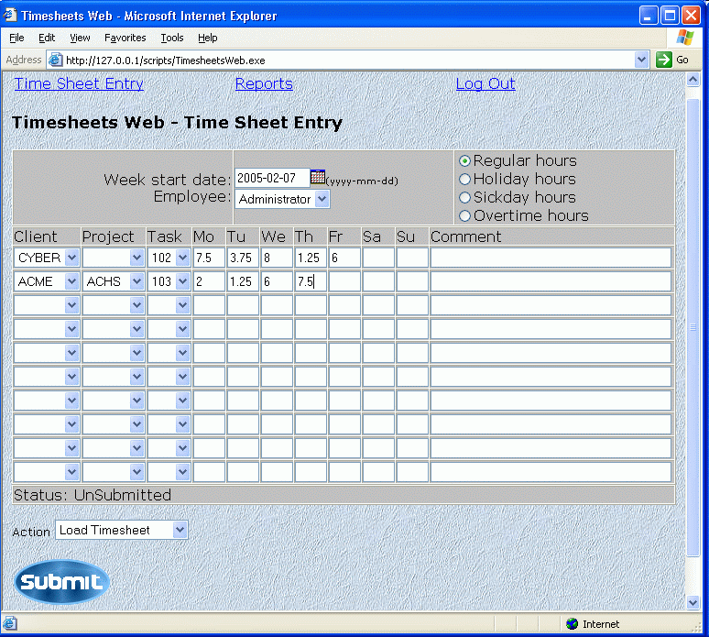
115/11/07

Slide 44
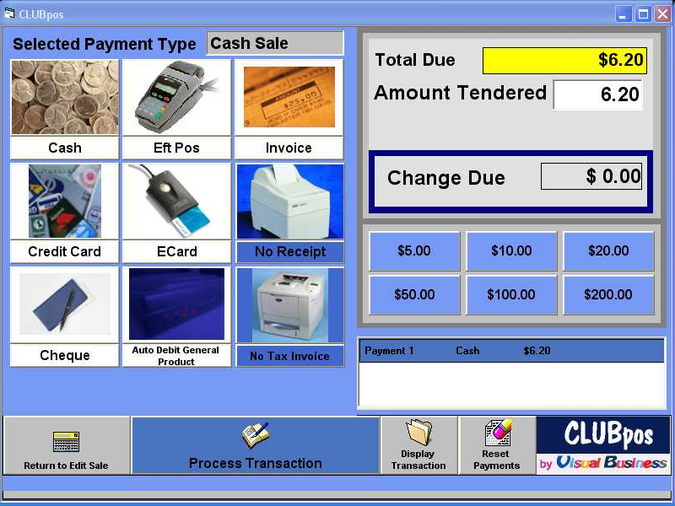
115/11/07

Slide 45
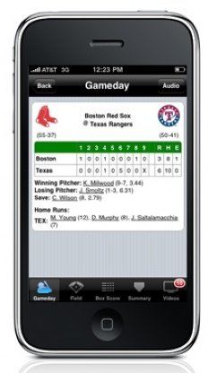
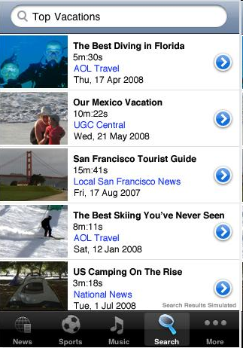
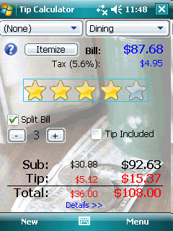
115/11/07

Slide 46
Demo of MockupScreens
http://mockupscreens.com/index.php?page=Free-Download
Internet links to User Interface Design and HCI:
http://www.usernomics.com/user-interface-design.html
115/11/07

